Slide 1

Event Management
....

Slide 2
Content
Introduction
Front-end

Slide 3
Introduction
Lumen Event Management System helps organizers plan, execute and report on events, driving success for their business.Lument event solution will allow event planners to book large-scale events, communicate with service providers, and maintain a single source of record for repeatable, measurable events.
Here we can get Event details for an event/campaign,creation/registration,capture Participant details for booking for an event,display the registered participants for a given
event.

Slide 4
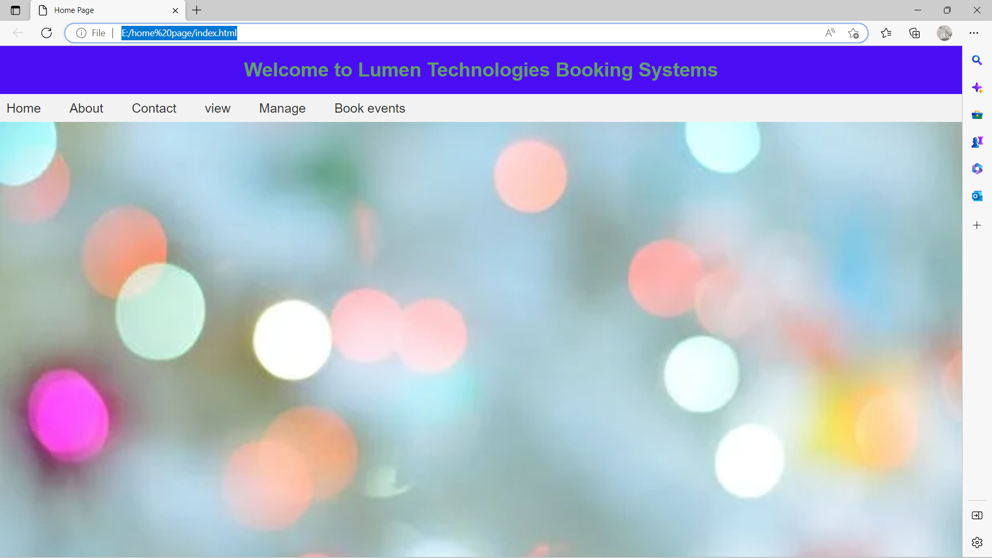
Front end

Slide 5
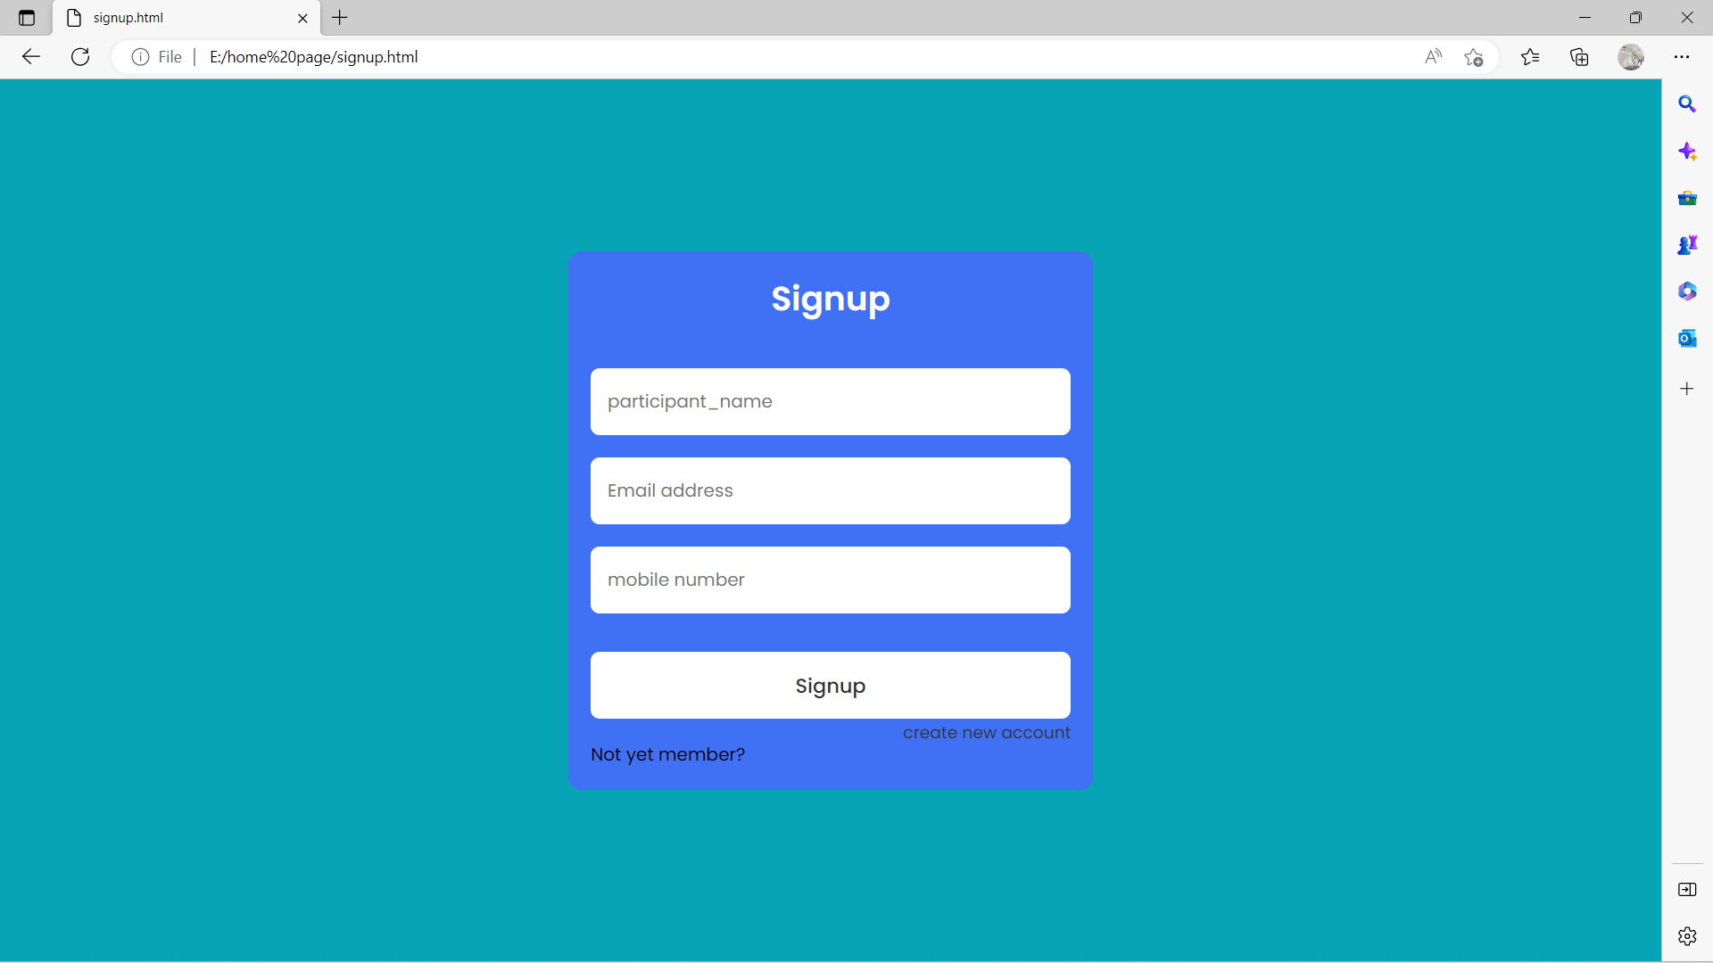

Slide 6
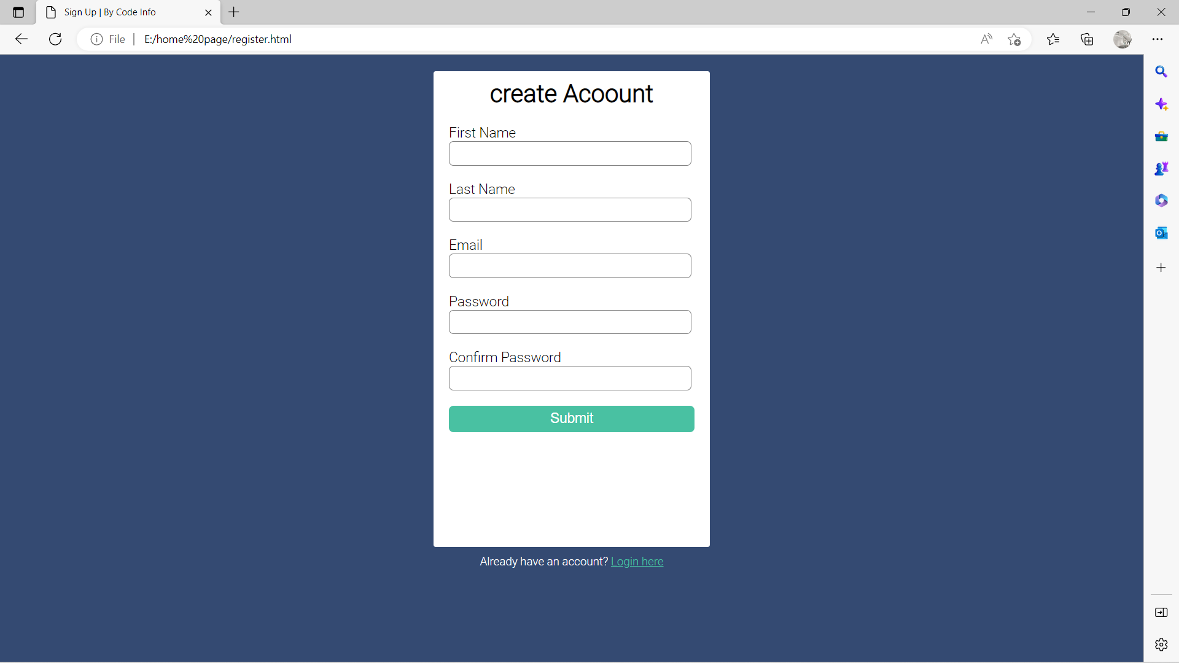

Slide 7
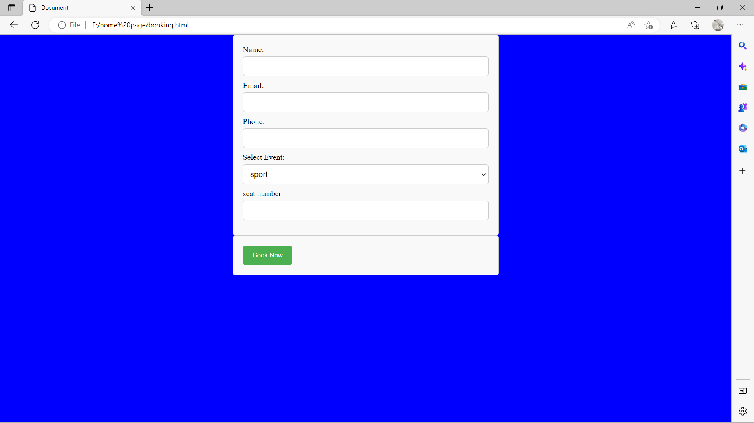

Slide 8
THANK YOU

